Slide 1
Optical frequency combs for astronomical observations
Hajime Inaba, Kaoru Minoshima, Atsushi Onae, and Feng-Lei Hong
National Metrology Institute of Japan (NMIJ),
National Institute of Advanced Industrial Science and Technology (AIST),
1-1-1 Umezono, Tsukuba, 305-8563 Ibaraki, Japan
8 Oct. 2009
Jozankei View Hotel

Slide 2
Outline
Time and Length standards
Optical frequency combs
Optical frequency measurement
Fiber-based frequency combs
Optical frequency combs for astronomical observations

Slide 3
Time and Length standards

Slide 4
Change of Time standards
（1967～）
Electron
Nucleus
Defined by the transition frequency
of cesium 133 atoms
The second is the duration of 9 192 631 770 periods of the radiation corresponding to the transition between the two hyperfine levels
of the ground state of the cesium 133 atom.
（1956～1967）
（～1956）
Defined by the earth's yearly round
1 year = 31 556 925.974 7 s
Defined by earth’s rotation
1 day = 86 400 s

Slide 5
Change of Length standards
（1983～）
Defined by the speed of light
The meter is the length of the path travelled by light in vacuum during a time interval of 1/299 792 458 of a second.
Defined by a wavelength
of krypton-86 radiation
1 m = 1650763.73 times
of the wavelength
（1960～1983）
Defined by the artifact international
prototype of platinum-iridium
（1889～1960）

Slide 6
c = νλ
Speed of light
Frequency
Wavelength
The list of recommended radiations was first published by the CIPM in 1983 (CI-1983, Recommendation 1) in the mise en pratique of the definition of the metre. This specified that the metre should be realized by one of the following methods:
by means of the length l of the path travelled in vacuum by a plane electromagnetic wave in a time t; this length is obtained from the measured time t, using the relation λ = c · t and the value of the speed of light in vacuum c = 299 792 458 m s^{–1}
by means of the wavelength in vacuum of a plane electromagnetic wave of frequency f; this wavelength is obtained from the measured frequency f using the relation λ = c/f and the value of the speed of light in vacuum c = 299 792 458 m s^{–1},
by means of one of the radiations from the list given here, whose stated wavelength in vacuum or whose stated frequency can be used with the uncertainty shown, provided that the given specifications and accepted good practice are followed.

Slide 7
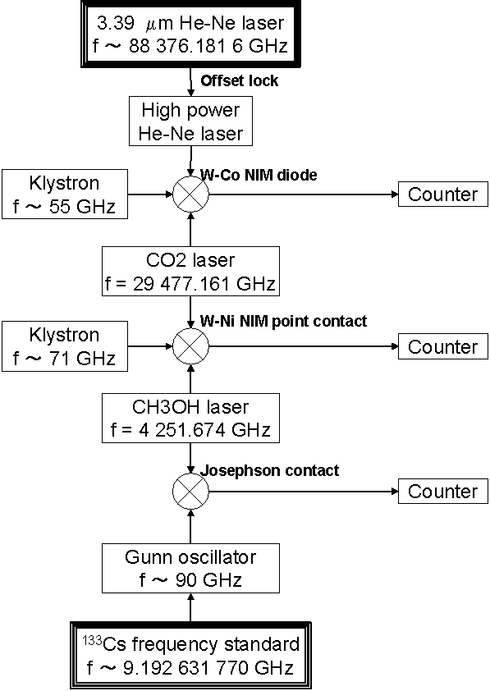
Optical frequency measurement (before frequency comb)
・ Overfull equipments, Several scientists, and several years project are required.
・ Specialized for one wavelength (can not be used for other wavelengths)
・ Very limited measure time
Reference: Y. Miki, A. Onae, T. Kurosawa, Y. Akimoto, and E. Sakuma, Japanese Journal of Applied Physics Part 1-Regular Papers Short Notes & Review Papers, vol. 33, pp. 1655-1658, Mar 1994.
The frequency chain developed by NRLM for 3.39 mm methane-stabilized laser (AIST, NMIJ at present

Slide 8
No. | Kind of laser | Absorbing atom/molecule | 遷移 | Component | Frequency | Wavelength in vacuum | Uncertainty (σ)
1.6 | Nd:YAG | ¹²⁷I₂ | R(56) 32-0 | a₁₀ | 563 260 223 513 kHz | 532 245 036.104 fm | 8.9 x 10⁻¹²
1.7 | He-Ne | ¹²⁷I₂ | R(127) 11-5 | a₁₆ or f | 473 612 353 604 kHz | 632 991 212.58 fm | 2.1 x 10⁻¹¹
1.10 |  | ⁸⁵Rb | 5S_{1/2} (F_{g}=3) -5D_{5/2} (F_{e}=5) | - | 385 285 142 375 kHz | 778 105 421.23 fm | 1.3 x 10⁻¹¹
1.11 |  | ¹³C₂H₂ | P(16) (ν₁+ν₂) | - | 194 369 569.4 MHz | 1 542 383 712 fm | 5.2 x 10⁻¹⁰
The most popular wavelength
standard in the world!
The list of the recommended radiations (extraction)

Slide 9
Optical frequency comb

Slide 10
Optical frequency comb
Time
f_{rep}
Optical pulse train on the time axis
Optical frequency comb
0
f_{ceo}
Frequency
f(N) = f_{ceo} + N・f_{rep}
Optical frequency
Microwave frequency
T. Udem et al. Phys. Rev. Lett. 82, 3568, 1999

Slide 11

National Institute of
Advanced Industrial Science and Technology (AIST)

Slide 12
Intensity
0
Frequency
Time

Slide 13
Optical frequency comb
Time
f_{rep}
Optical pulse train on the time axis
Optical frequency comb
0
f_{ceo}
Frequency
f(N) = f_{ceo} + N・f_{rep}
This frequency exists because of a
change of a carrier phase to an optical
pulse envelope

Slide 14
Carrier Envelope Offset frequency f_{ceo}
10～100 fs
φ_{ceo} (carrier envelope offset phase)
0
Time domain
7 ns (f_{rep} = 150 MHz)
D. J. Jones et. al. Science 288, 635-639 (2000).

Slide 15

Difference between a reflection index and a group index
http://www.mpq.mpg.de/~haensch/comb/research.html

Slide 16
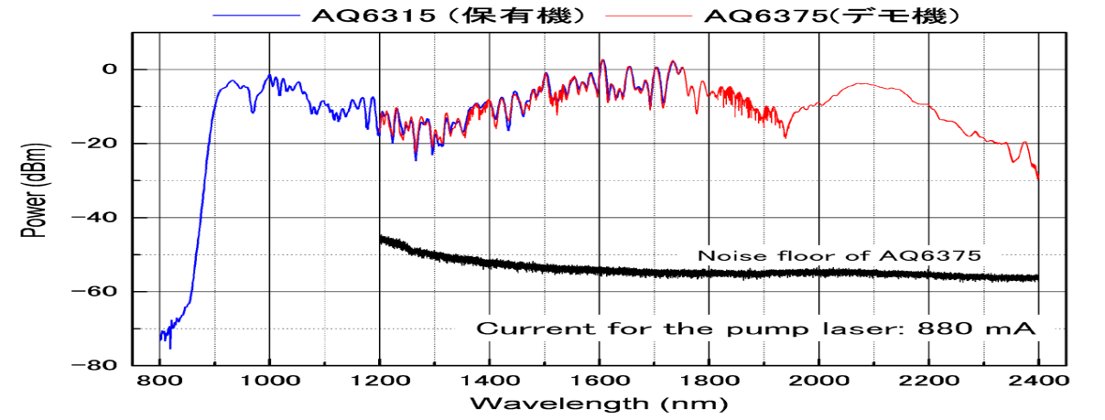

Octave-spanning comb
Er:fiber laser + Highly Nonlinear Fiber (HNLF) (1000 – 2000 nm)
Wavelength
400
600
800
1000
1200
Ti:sapphire laser + Photonic Crystal Fiber (PCF) (500 – 1100 nm)

Slide 17
Detection of f_{ceo}
f_{rep}
f_{ceo}
f(N) = f_{ceo} + N･f_{rep}
f(2N) = f_{ceo} + 2N･f_{rep}
2f (N) = 2f_{ceo} + 2N･f_{rep}
2f (N) – f(2N) = f_{ceo}
f_{ceo} can be detected from optical frequency comb!
H. R. Telle et al. Appl. Phys. B 69, 327-332, 1999

Slide 18
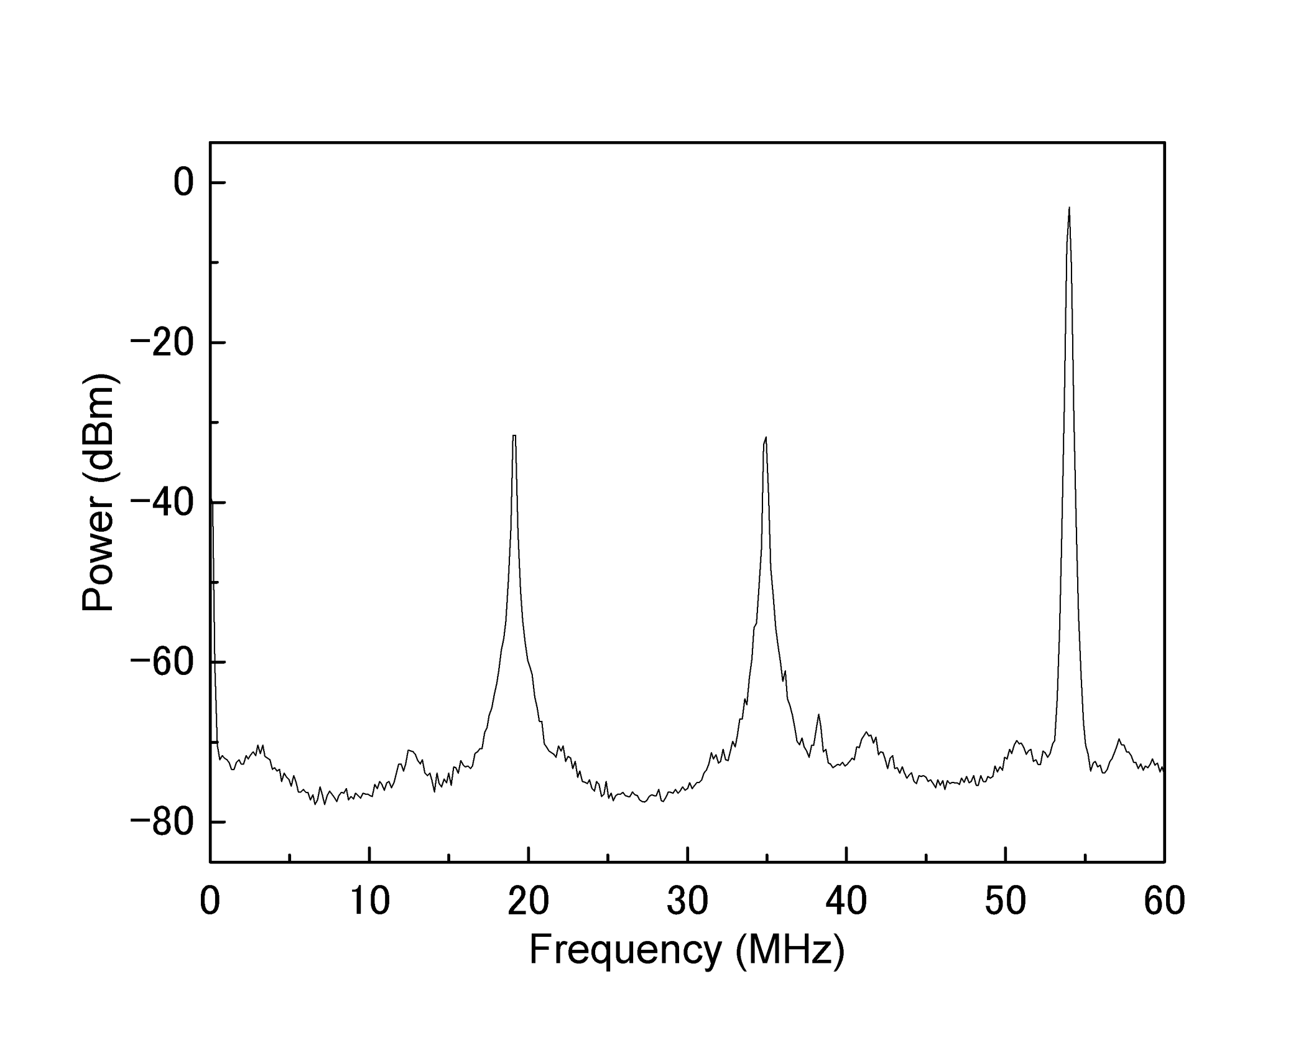
Carrier envelope offset beat
f_{rep}
f_{ceo}
f_{rep} - f_{ceo}
45dB at 100 kHz RBW

Slide 19
f_{rep}
0
f_{ceo}
Free run
Stabilize the f_{rep}！
Stabilize the f_{ceo}！

Slide 20
Optical frequency measurement

Slide 21
Optical frequency measurement by a optical frequency comb
50 MHz
Measured laser
f_{beat}
Detector
f_{rep}
f_{rep} - f_{beat}
0
Optical frequency
Frequency range 200 THz
Filter &
Amplifier
f_{beat}
……
f_{rep}
0
f_{rep} - f_{beat}
50
100 MHz
Electrical frequency
Frequency
counter
Optical freq of Measured laser
= reference of the ruler + beat signal frequency

Slide 22
Optical frequency measurement
f = f(0) + N･f_{rep} + f_{b}
f_{ｂ}
f_{rep}
f_{ceo}
f(N) = f_{ceo} + N･f_{rep}
The measurement is achieved by counting the
frequency of the beat note between the comb
stabilized to a reference microwave and a
measured laser.

Slide 23
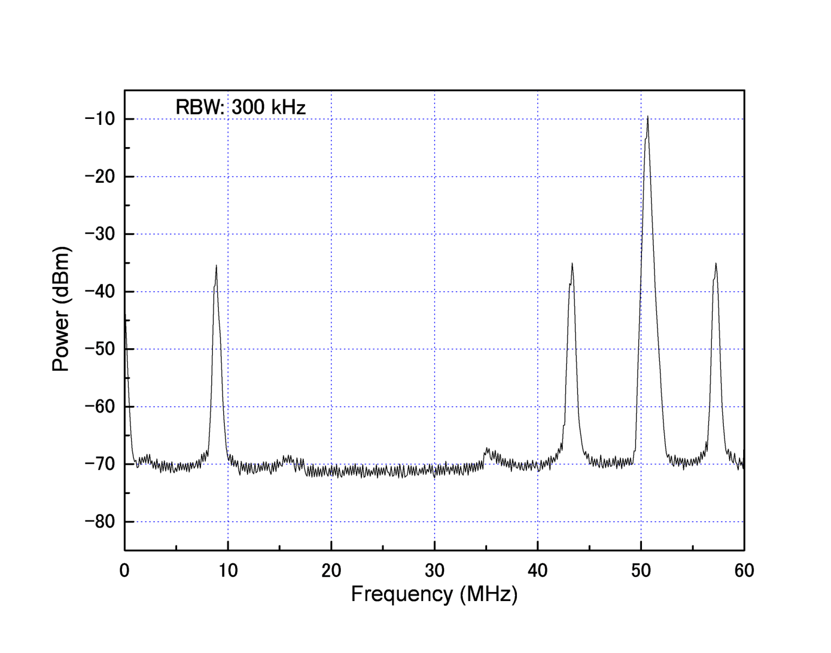
Beat note between a CW laser and a comb
Ex. Beat note between a 633 nm HeNe laser and a comb
f_{rep}
f_{beat}
f_{rep} - f_{beat}
We have obtained
sufficiently high S/N
with a 578 nm laser: 35dB
with a 633 nm laser: 35dB
with a 778 nm laser: 35dB
with a 1064 nm laser: 35dB
with a 1542 nm laser: 40dB
（300 kHz RBW）

Slide 24
Fiber-based frequency combs

Slide 25
Two types of comb
Ti:sapphire based comb and Fiber-based comb
Er:fiber laser + Highly Nonlinear Fiber (HNLF) (1000 – 2000 nm)
Wavelength
400
600
800
1000
1200
Ti:sapphire laser + Photonic Crystal Fiber (PCF) (500 – 1100 nm)

Slide 26
Which comb do you prefer?
Ti:sapphire based frequency comb
Short wavelength, high power
Need frequent alignments and cleaning
Difficult to operate for long period of time
Need bulky and expensive solid state laser
Fiber based frequency comb
Not need alignments and cleaning
Possible to operate for long period of time (over 1 week)
Compact and cheap pump laser
Fiber based frequency comb is better in most applications
unless you do not want to use an UV comb.

Slide 27
History of fiber based comb
1. Optical frequency measurement (A.Onae, et al. Opt. Comm. 183, 181, 2000)
2. Observation of Carrier Envelope Offset beat (F. Tauser et al. Opt. Exp. 11, 594, 2003)
3. CEO observation using 2 f to3 f interferometer （F.-L. Hong, et al. Opt. Lett. 28, 1516, 2003)
4. Phase locking of CEO (B. Washburn, et al. Opt. Lett. 29, 250, 2004)
5. Absolute frequency measurement (T. Schibli, et al. Opt. Lett. 29, 2467, 2004)
6. Two branch system (F. Adlar, et al. Opt. Exp. 12, 5872, 2004)
7. Comparison between two fiber based combs (P. Kubina, et al. Opt. Exp. 13, 904-909 2005)
8. Long term measurement over a week (H. Inaba et al. Opt. Exp. 14, 5223, 2006)
9. Determination of mode number using two combs (J.-L. Peng et al. Opt. Exp. 15, 4485, 2007)
10. Suppression of phase noise of fiber comb (J. J. Mcferran et al. Appl. Phys. B 86, 219, 2007)
11. Narrow linewidth comb (A. Bartels et al. Opt. Lett. 29, 1081, 2004) (W. C. Swann et al. Opt. Lett. 31, 3046, 2006) (T. R. Schibli et al. Nature Photonics 2, 355, 2008) (M. J. Martin et al. Opt. Exp. 17, 558, 2009)

Slide 28
Fiber based frequency comb developed at NMIJ, AIST
f
C
E
O
s
t
a
b
i
l
i
z
a
t
i
o
n
λ
/
4
L
λ
/
2
H
M
B
P
F
H
N
L
F
P
D
λ
/
2
PPLN
for 2040 nm
P
S
I
P
u
m
p
l
a
s
e
r
P
u
m
p
l
a
s
e
r
1
.
4
8
μ
m
E
r
:
f
i
b
e
r
μ
P
D
P
I
I
0
.
9
8
m
E
r
:
f
i
b
e
r
λ
/
4
P
L
λ
/
4
L
+
D
r
u
m
P
Z
T
H
N
L
F
633 nm
comb
λ
/
2
λ
/
2
PPLN
for 1266 nm
H. Inaba et al. Opt. Exp. 14, 5223, 2006
f
r
e
p
s
t
a
b
i
l
i
z
a
t
i
o
n
M. Nakazawa, et al. Electron. Lett. 29, 1327, 1993
Two branch system
Backward pumping only
EDF: 4 m
Output: 50-65 mW
Pump power: 400 mW (typical)
f_{rep} : 50.5 MHz
EDF: 90 cm
Output: 5 mW
Pump power: 200 mW (typical)
Total dispersion: +0.006±0.005 ps²
F. Adlar, et al. Opt. Exp. 12, 5872, 2004

Slide 29
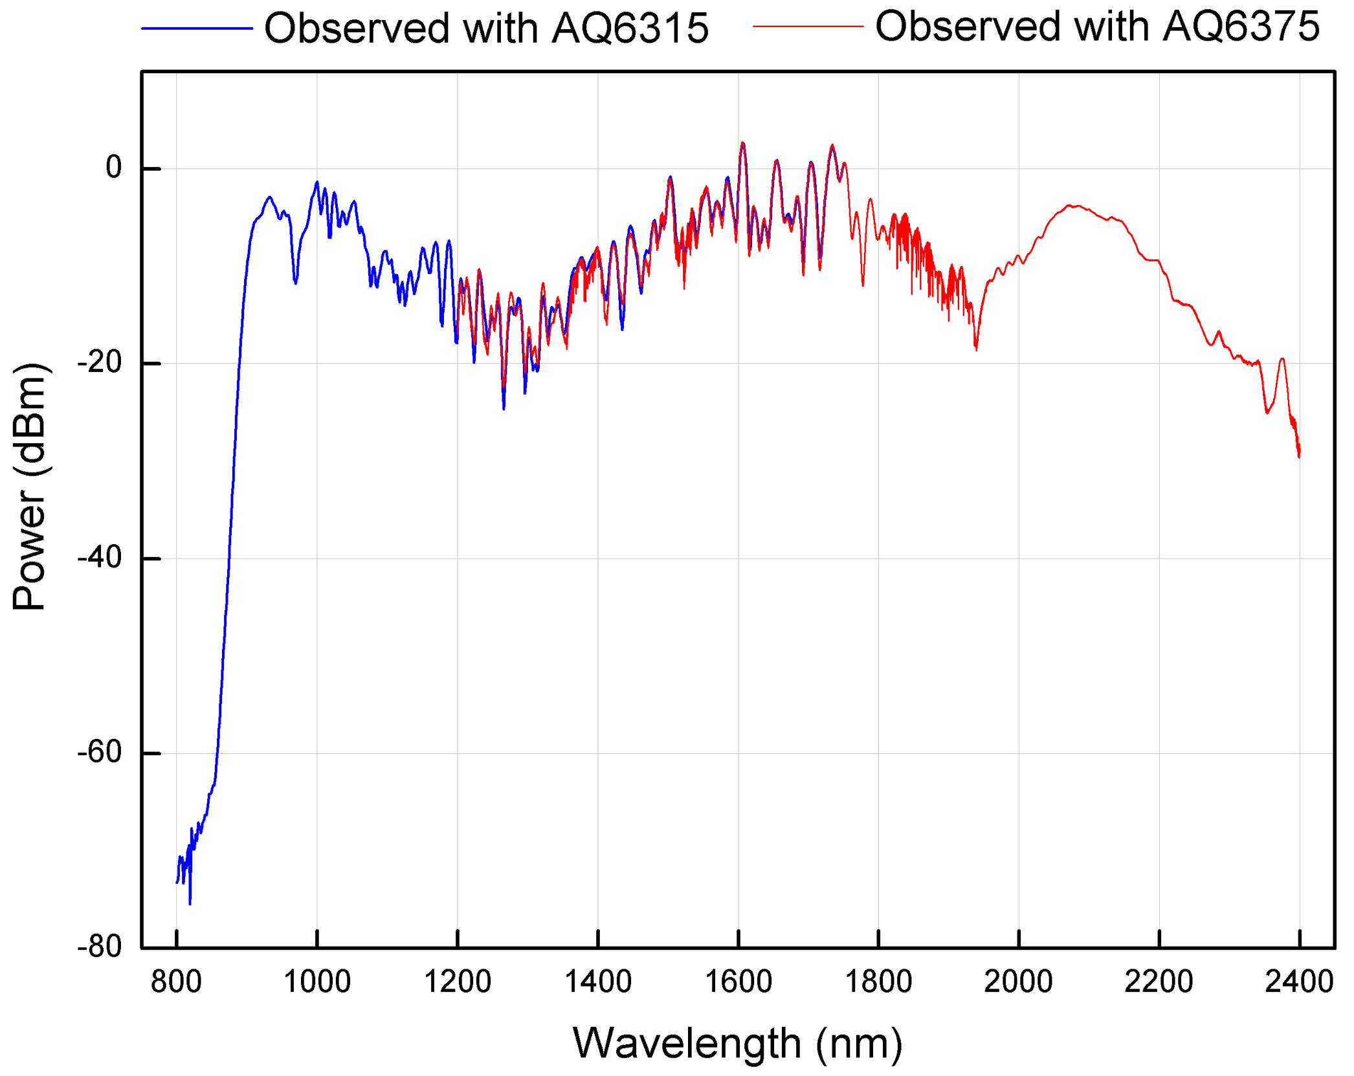
HNLF and octave-spanning comb
f_{CEO} detection

Slide 30
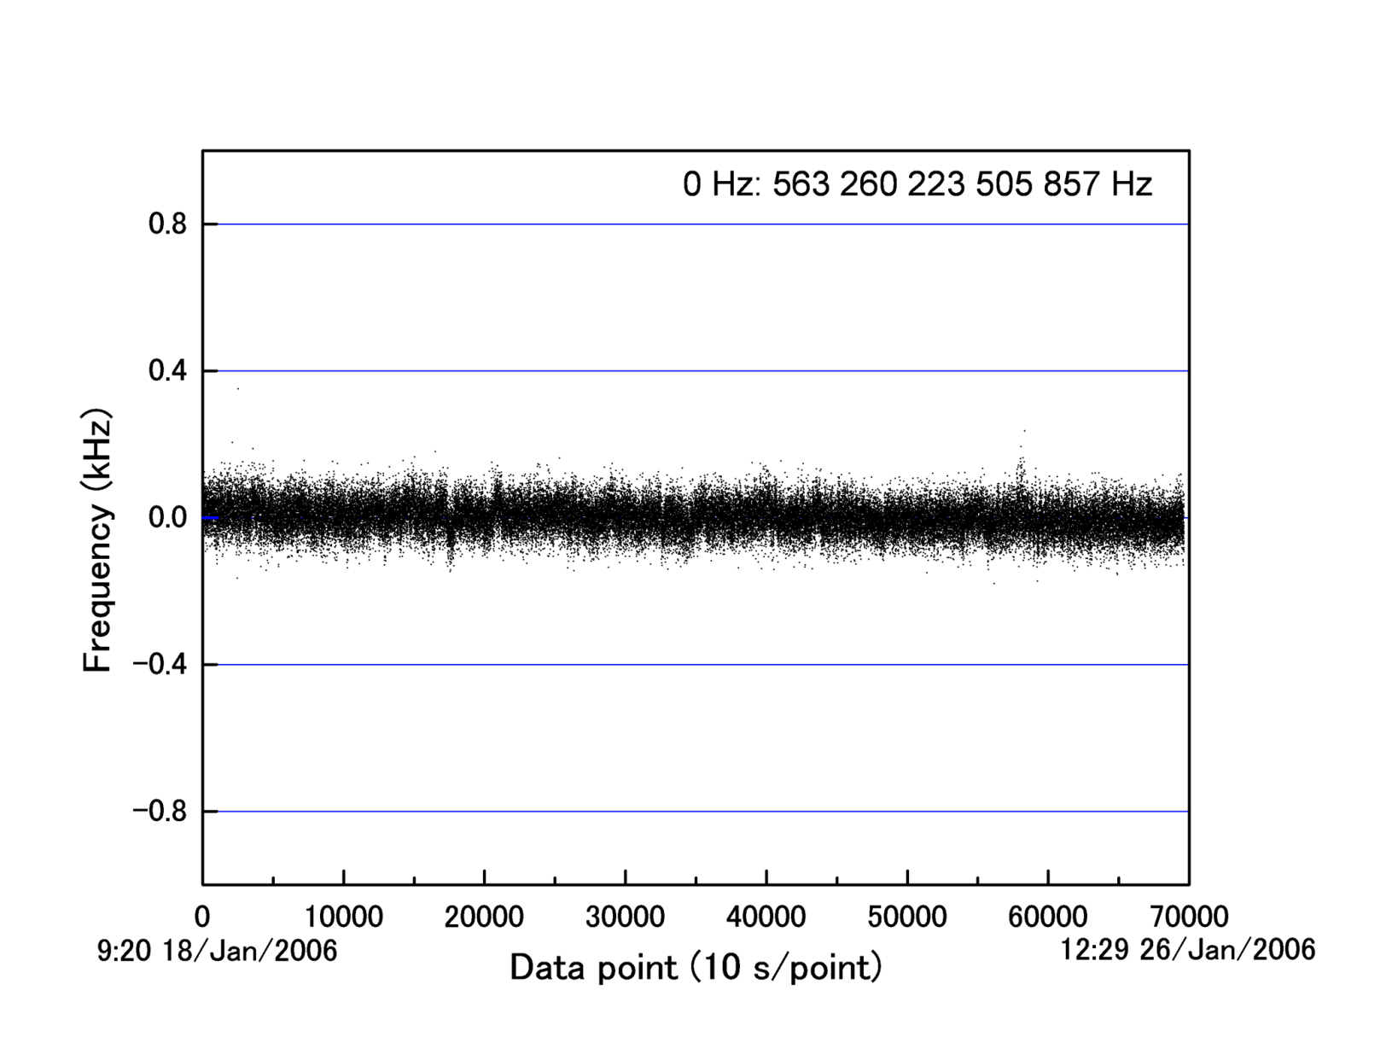
Long-term frequency measurement of iodine stabilized Nd:YAG laser
A long term measurement for over 1 week is achieved.

Slide 31
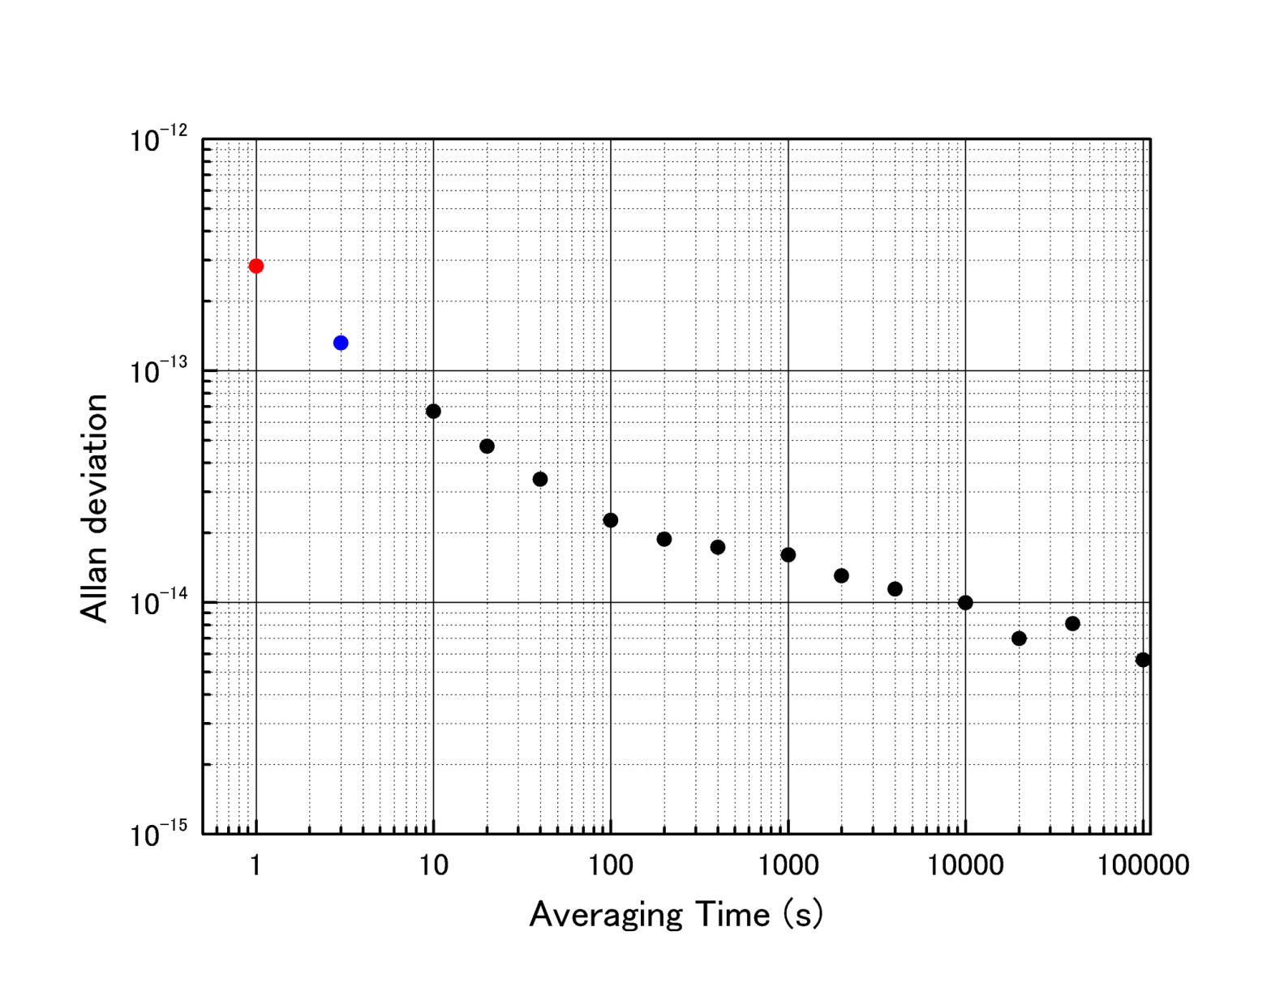
Long-term frequency measurement of iodine stabilized Nd:YAG laser
The precision of the comb basically depend on the precision of the reference.

Slide 32
Measurement limit of the combs
Comb
#1
Reference
microwave
Frequency
Stabilized
laser
Comb
#2
The most simple way as a validation of a comb to compare two!
P. Kubina, et al. Opt. Exp. 13, 904-909 2005

Slide 33
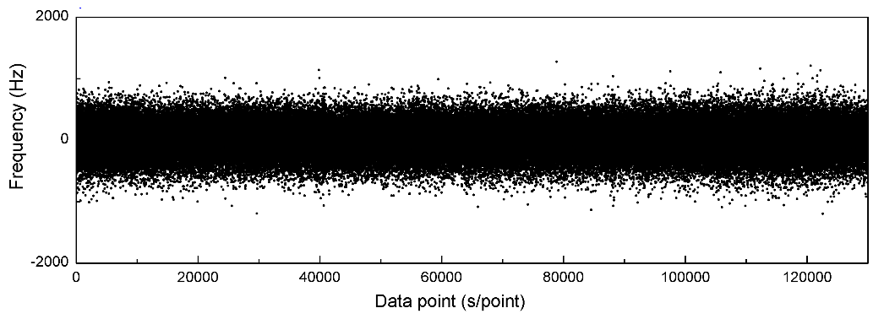
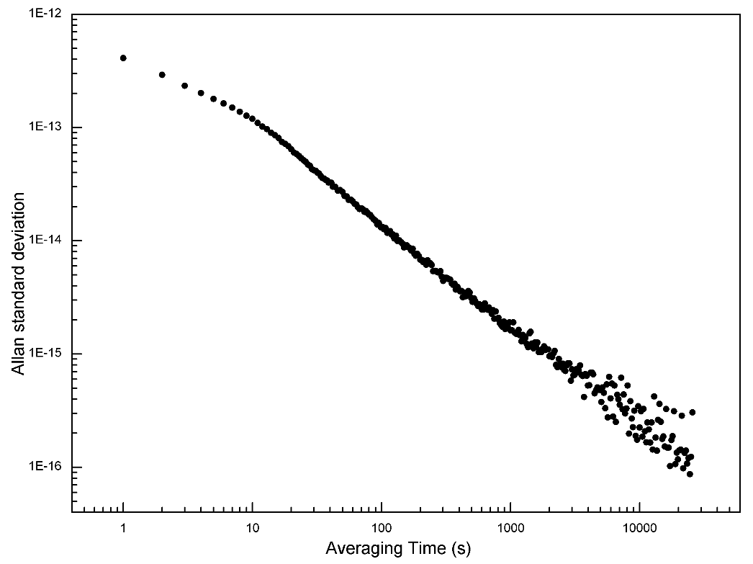
Frequency difference
between two combs
Average: +38 mHz
(8E-17)
Corresponding Allan
standard deviation

Slide 34
We fabricate combs by ourselves
For our applications (optical clocks, national standards of length and so on)
For other applications (high-resolution spectroscopy, tera-hertz synthesizer, length measurement and so on)
Portable comb system (collaborating with a company)

Slide 35
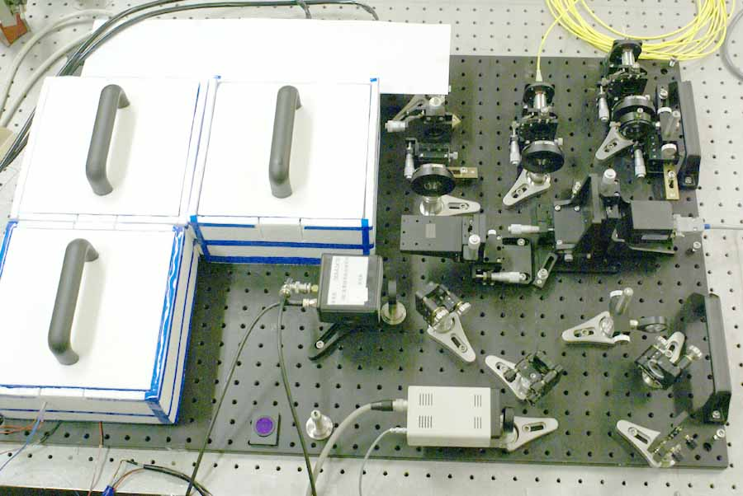
The transported comb developed by NMIJ
Broadband IR comb from amp #1 “Common-path” Interferometer to detect f_{CEO}
633nm test laser
Broadband IR comb from amp #2
Amplifier #1
to detect f_{CEO}
Amplifier #2
to detect f_{beat}
Femtosecond laser
Notes:
Sydney

Slide 36
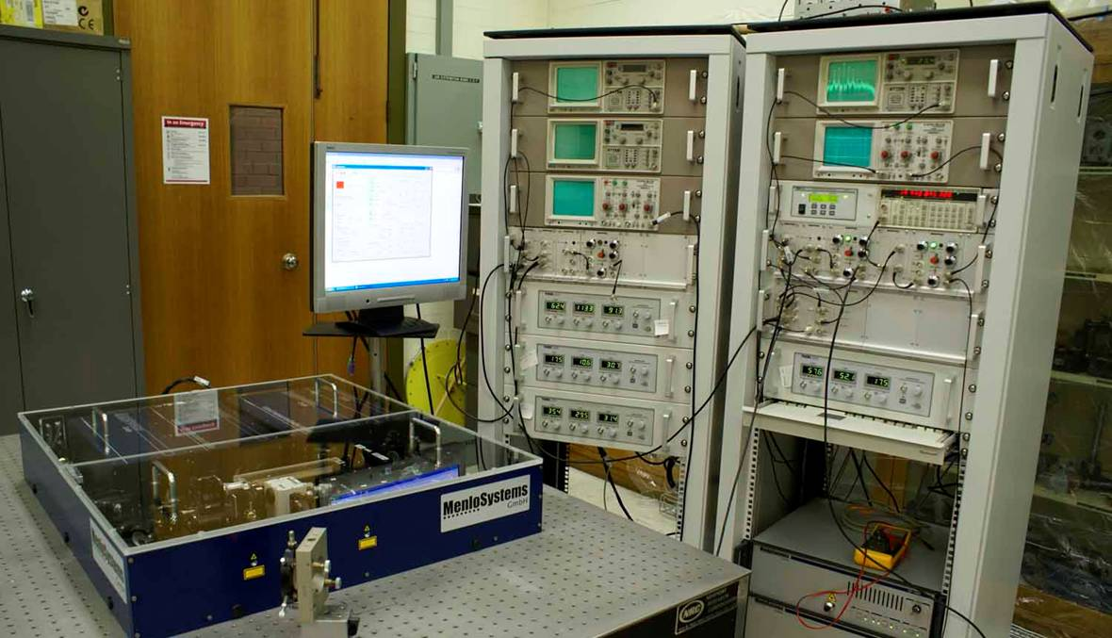
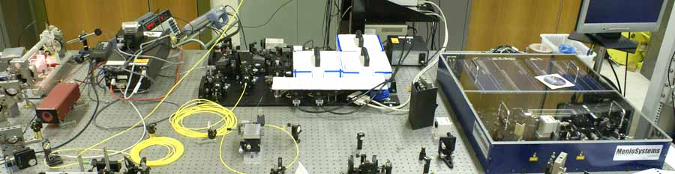
The Menlo Comb purchased by NMIA
Mode-locked Er fibre laser
Continuum generation in photonic crystal fibre
Control electronics to stabilise f_{r} and f₀ and
measure δ
Reference electronics externally to UTC(AUS)
10 MHz frequency
Offset laser
NMIJ comb
NMIA comb

Slide 37
Optical frequency combs for astronomical observations

Slide 38
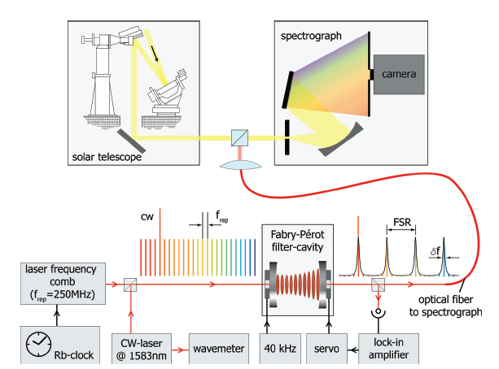
Features of the comb for
astronomical observations
Rubidium clock is the reference microwave frequency for the comb.
The wavelength is determined with a spectrograph not a frequency counter.
A CW laser and a wavemeter is used to determine “the mode number” of the comb.
An “extraction of comb modes” is required to avoid an overcrowded comb.
The wavelength is in the 1.5 mm region?
Super long-term operation is required.
T. Steinmetz, et al., Science 321, 1335, 2008

Slide 39
Our status for developing combs for Astronomical Observations
Rubidium clock is the reference microwave frequency for the comb.
Required uncertainty (precision) of comb itself is 10⁻¹¹ level? -> Easy!
2. The wavelength is determined with a spectrograph not a frequency counter.
We do not have any experience to determine a wavelength with such a spectrograph. But this technique is yours?
3. A CW laser and a wavemeter is used to determine “the mode number” of the comb.
The mode number of comb can be determined by using high resolution wavemeter or using two combs referring a common reference frequency.

Slide 40
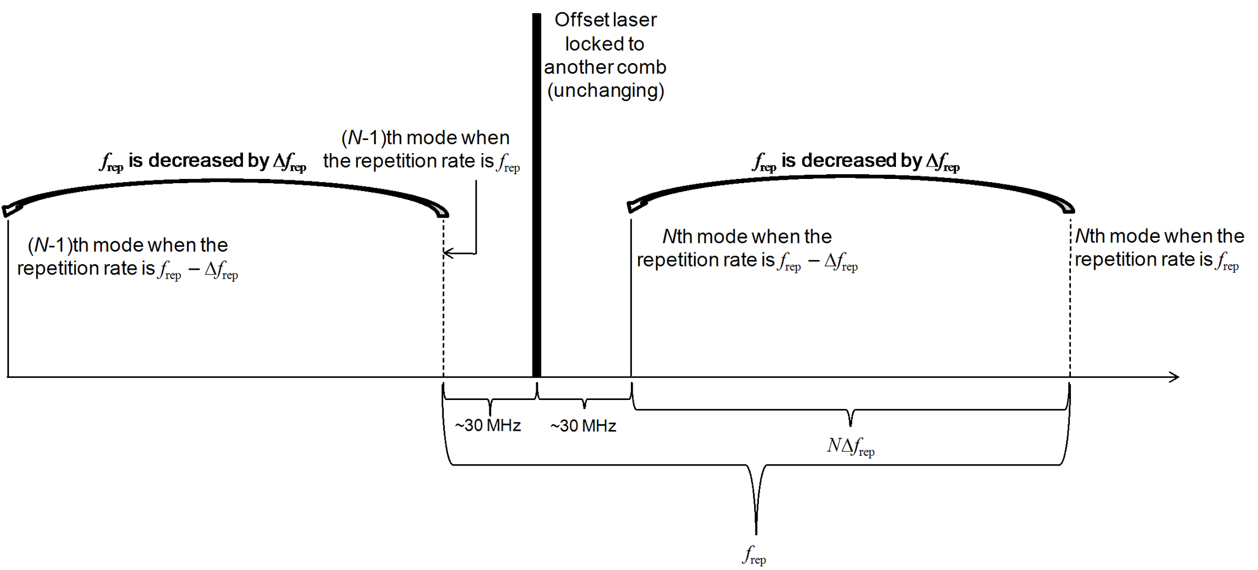
Mode number determination using two combs
f_{beat1}
f_{beat2}
f(N) + Δ f(N) = N(f_{rep} + Δ f_{rep}) ± f_{CEO}
H. Inaba et al. IEEE Trans. on Instru., 58, 1234, 2009
Δ f(N) = NΔ f_{rep}
N = (f_{rep} - f_{beat1} - f_{beat2})/ Δ f_{rep}
f_{rep} = f_{beat1} + f_{beat2} + Δf(N)

Slide 41
Mode number determination using two combs
 | Average (Hz) | Allan deviation at 1000 s averaging (Hz) | Data number and averaging time (s)
f_{rep} | 99 999 825 (set) | - | -
Δf_{rep} | 8 (set) | - | -
f_{beat} 1 | 30 304 278.32 | 0.87 | 50 x 1 000
f_{beat} 2 | 31 806 450.69 | 0.94 | 50 x 1 000
N = (f_{rep} - f_{beat1} - f_{beat2}) / Δf_{rep} = 4 736 137.00 (0.16)
N was identified with 4 736 137.

Slide 42
Our status for developing combs for Astronomical Observations
4. An “extraction of comb modes” is required to avoid an overcrowded comb.
Developing for other applications at present -> Improving robustness is challenging.
5. The wavelength is in the 1.5 mm region?
Our comb can be generated between 500 – 2000 nm.
6. Super long-term operation is required.
Long-term operation more than 1 month is achieved. (As for the comb itself)

Slide 43
Our status for developing combs for Astronomical Observations
We hope to cooperate with you!
and
(I suppose) we can develop the comb you want!
Please contact us!
Thank you for your attention!

