Slide 1
Planet Characterization by Transit Observations
Norio Narita
National Astronomical Observatory of Japan

Slide 2
Outline
Introduction of transit photometry
Further studies for transiting planets
Future studies in this field

Slide 3
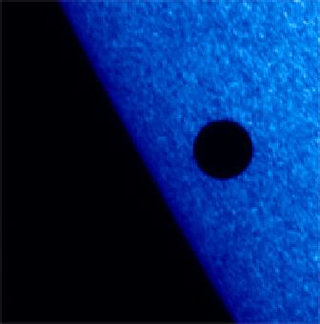
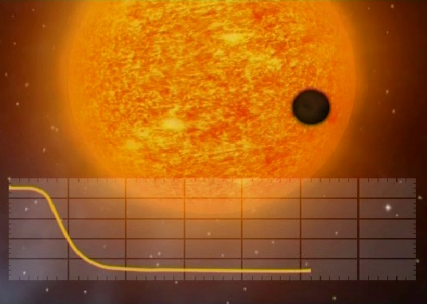
Planetary transits
transit in the Solar System
transit in exoplanetary systems
(we cannot spatially resolve)
2006/11/9
transit of Mercury
observed with Hinode
slightly dimming
If a planetary orbit passes in front of its host star by chance,
we can observe exoplanetary transits as periodical dimming.

Slide 4
The first exoplanetary transits
Charbonneau+ (2000)
for HD209458b

Slide 5
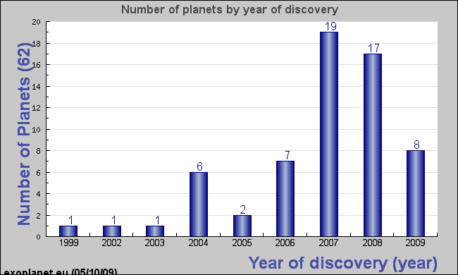
Transiting planets are increasing
So far 62 transiting planets have been discovered.

Slide 6
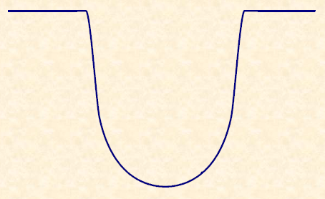




Gifts from transit light curve analysis
stellar radius, orbital inclination, mid-transit time
radius ratio
limb-darkening coefficients
planetary radius
Mandel & Agol (2002), Gimenez (2006), Ohta+ (2009)
have provided analytic formula for transit light curves

Slide 7


Additional observable parameters
planet radius
orbital inclination
planet mass
planet density
In combination with RVs
We can learn radius, mass, and density of transiting planets
by transit photometry.

Slide 8
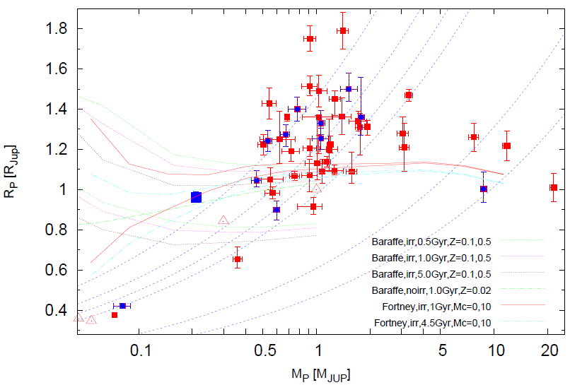
Distribution of planetary mass/size
inflated!
HAT-P-3
HD149026
CoRoT-7
Hartman+ (2009)

Slide 9
Diversity of Jovian planets
(too inflated)
HAT-P-3 b
(massive core)
TrES-4 b, etc
Charbonneau+ (2006)

Slide 10
What can we additionally learn?
Further Spectroscopy
  The Rossiter-McLaughlin Effect
  Transmission Spectroscopy
Further Photometry
  Transit Timing Variations

Slide 11
The Rossiter-McLaughlin effect

Slide 12
The Rossiter-McLaughlin effect
When a transiting planet hides stellar rotation,
star
planet
planet
hide approaching side
→ appear to be receding
hide receding side
→ appear to be approaching
radial velocity of the host star would have
an apparent anomaly during transit.

Slide 13
What can we learn from RM effect?
The shape of RM effect
depends on the trajectory of the transiting planet.
well aligned
misaligned
RVs during transits = the Keplerian motion and the RM effect
Gaudi & Winn (2007)

Slide 14




Observable parameter
λ： sky-projected angle between
the stellar spin axis and the planetary orbital axis
(e.g., Ohta+ 2005, Gimentz 2006, Gaudi & Winn 2007)

Slide 15
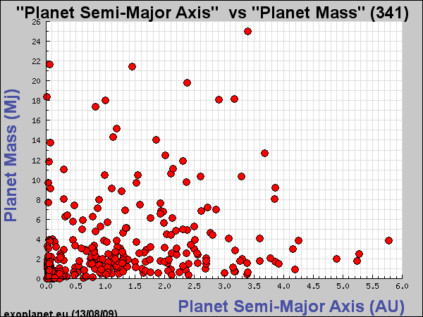
Semi-Major Axis Distribution of Exoplanets
Snow line
Jupiter
Need planetary migration mechanisms!

Slide 16
Standard Migration Models
Type I and II migration mechanisms
consider gravitational interaction between
  proto-planetary disk and planets
    Type I: less than 10 Earth mass proto-planets
    Type II: more massive case (Jovian planets)
well explain the semi-major axis distribution
  e.g., a series of Ida & Lin papers
predict small eccentricities for migrated planets

Slide 17
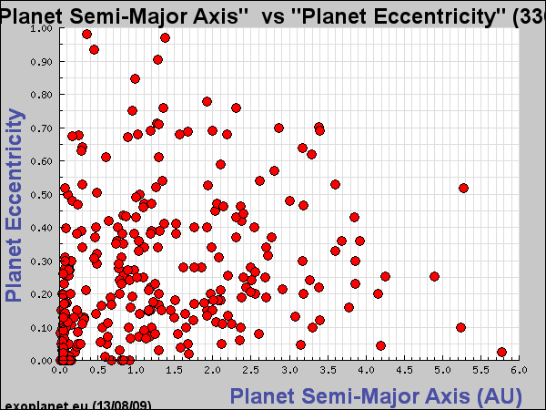
Eccentricity Distribution
Eccentric Planets
Jupiter
Cannot be explained by Type I & II migration model.

Slide 18
Migration Models for Eccentric Planets
consider gravitational interaction between
  planet-planet (planet-planet scattering models)
  planet-binary companion (the Kozai migration)
may be able to explain eccentricity distribution
  e.g., Nagasawa+ 2008, Chatterjee+ 2008
predict a variety of eccentricities and also misalignments between stellar-spin and planetary-orbital axes

Slide 19
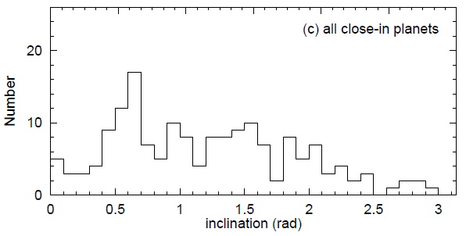
Example of Misalignment Prediction
Misaligned and even retrograde planets are predicted.
0
30
60
90
120
150
180 deg
Nagasawa, Ida, & Bessho (2008)
How can we confirm these models by observations?

Slide 20
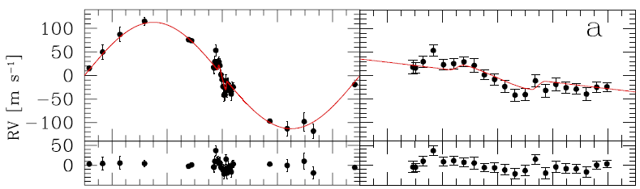
Prograde Exoplanet: TrES-1b
Our first observation with Subaru/HDS.
NN et al. (2007)
Thanks to Subaru, clear detection of the Rossiter effect.
We confirmed a prograde orbit and
the spin-orbit alignment of the planet.

Slide 21
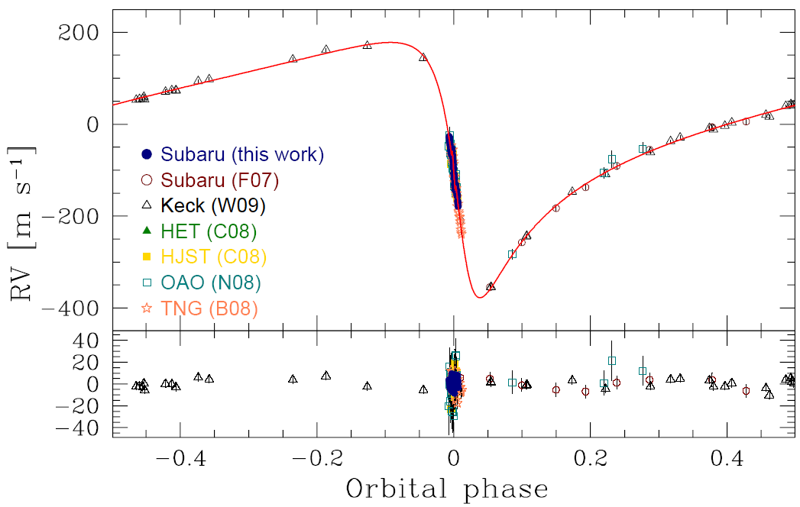
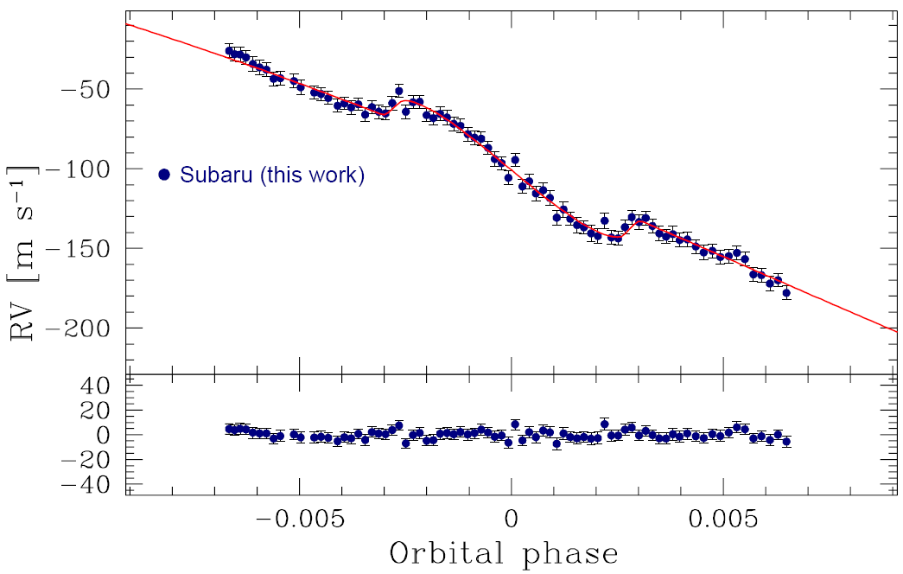
Aligned Ecctentric Planet: HD17156b
Eccentric planet with the orbital period of 21.2 days.
NN et al. (2009a)
λ = 10.0 ± 5.1 deg
Well aligned in spite of its eccentricity.

Slide 22
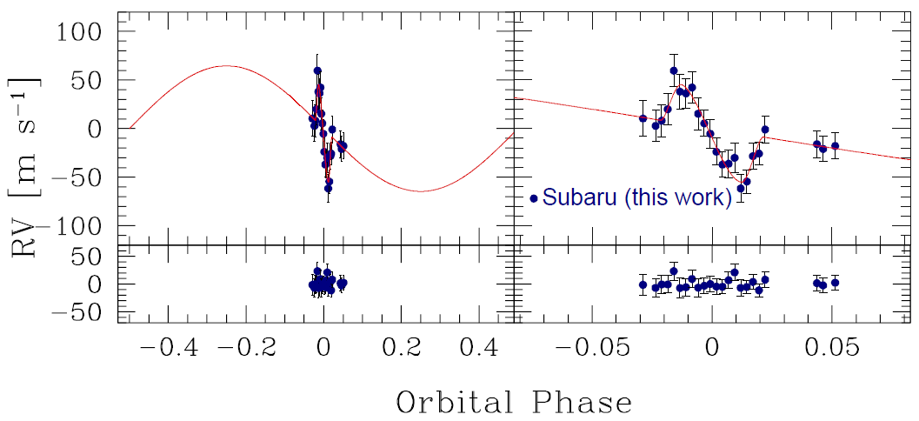
Aligned Binary Planet: TrES-4b
NN et al. in prep. λ = 5.3 ± 4.7 deg
NN et al. in prep.
Well aligned in spite of its binarity.

Slide 23
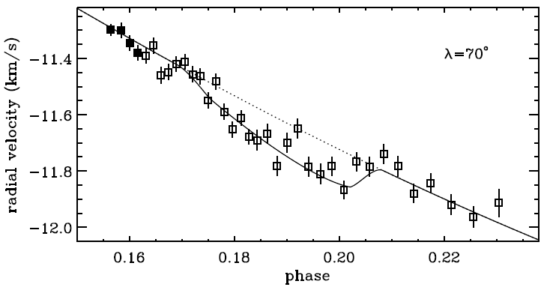
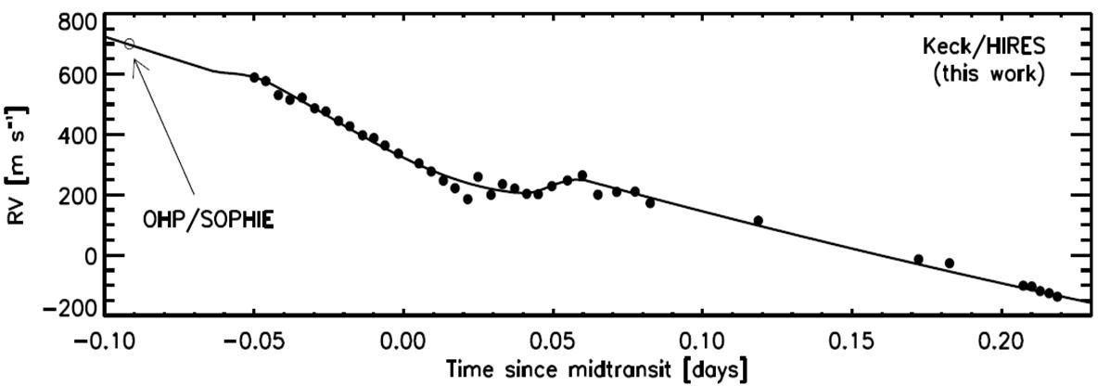
Misaligned Exoplanet: XO-3b
Hebrard et al. (2008)
λ = 70 ± 15 deg
Winn et al. (2009a)
λ = 37.3 ± 3.7 deg

Slide 24
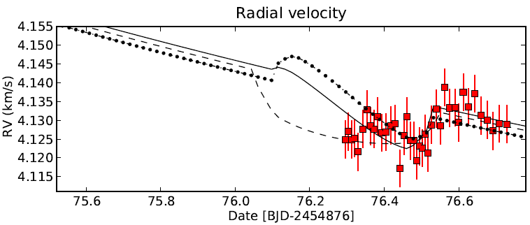
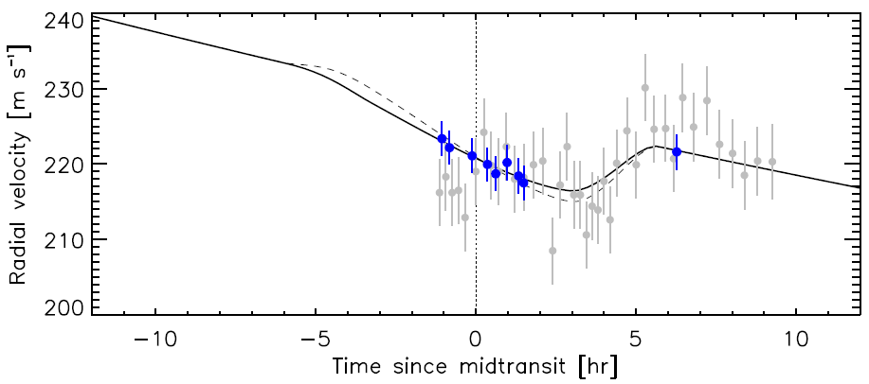
Misaligned Exoplanet: HD80606b
Pont et al. (2009)
λ = 50 (+61, -36) deg
Winn et al. (2009b)
λ = 53 (+34, -21) deg

Slide 25
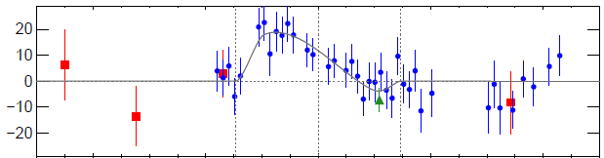
Misaligned Exoplanet: WASP-14b
Johnson et al. (2009)
λ = -33.1 ± 7.4 deg

Slide 26
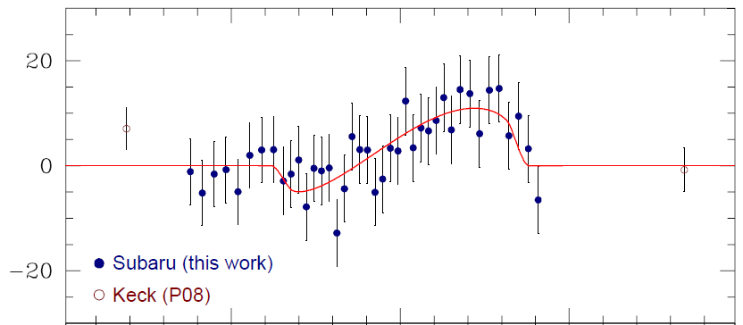
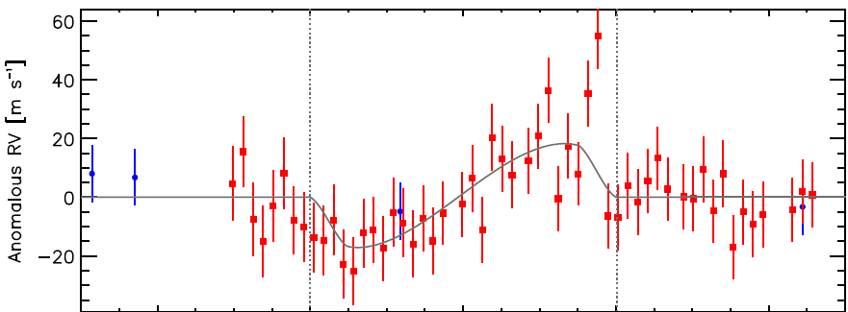
First Retrograde Exoplanet: HAT-P-7b
NN et al. (2009b)
λ = -132.6 (+12.6, -21.5) deg
Winn et al. (2009c)
λ = -177.5 ± 9.4 deg

Slide 27
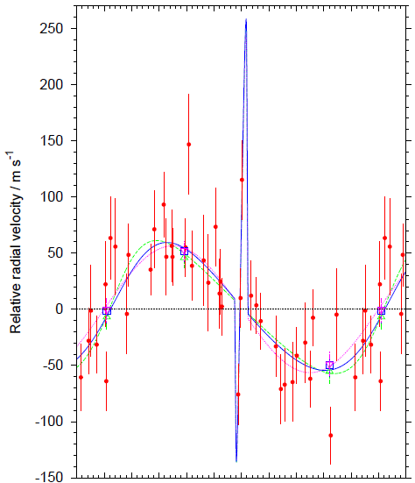
Probable Retrograde Planet: WASP-17b
Anderson et al. (2009)

Slide 28
Previous studies
HD209458 Queloz+ 2000, Winn+ 2005
HD189733 Winn+ 2006
TrES-1 Narita+ 2007
HAT-P-2 Winn+ 2007, Loeillet+ 2008
HD149026 Wolf+ 2007
HD17156 Narita+ 2008,2009, Cochran+ 2008, Barbieri+ 2009
TrES-2 Winn+ 2008
CoRoT-2 Bouchy+ 2008
XO-3 Hebrard+ 2008, Winn+ 2009
HAT-P-1 Johnson+ 2008
HD80606 Moutou+ 2009, Pont+ 2009, Winn+ 2009
WASP-14 Joshi+ 2008, Johnson+ 2009
HAT-P-7 Narita+ 2009, Winn+ 2009
WASP-17 Anderson+ 2009
CoRoT-1 Pont+ 2009
TrES-4 Narita+ to be submitted
Red: Eccentric

Slide 29
Summary of Previous RM Studies
Exoplanets have a diversity in orbital distributions
We can measure spin-orbit alignment angles of exoplanets by spectroscopic transit observations
  4 out of 6 eccentric planets have misaligned orbits
  2 out of 10 non-eccentric planets also show misaligned orbits
  Recent observations support planetary migration models considering not only disk-planet interactions, but also planet-planet scattering and the Kozai migration
The diversity of orbital distributions would be brought by the various planetary migration mechanisms

Slide 30
Transmission Spectroscopy

Slide 31



Transmission Spectroscopy
star
A tiny part of starlight passes through planetary atmosphere.

Slide 32
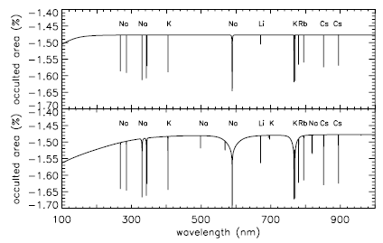
Theoretical studies for hot Jupiters
Seager & Sasselov (2000)
Brown (2001)
Strong excess absorptions were predicted especially
in alkali metal lines and molecular bands

Slide 33
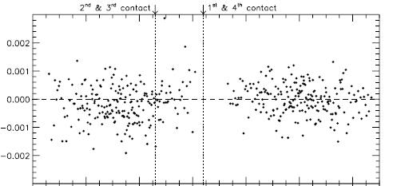
Components discovered in optical
Sodium
  HD209458b
    Charbonneau+ (2002) with HST/STIS
    Snellen+ (2008) with Subaru/HDS
in transit
out of transit
Charbonneau+ 2002
Snellen+ 2008

Slide 34
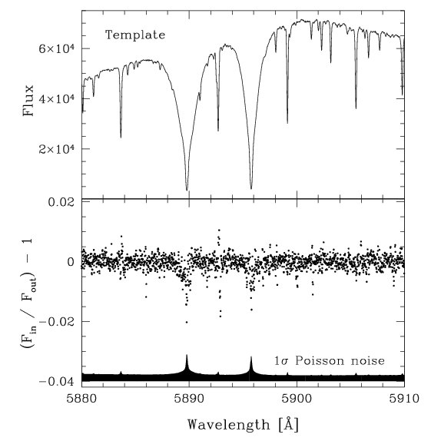
Components discovered in optical
Sodium
  HD189733b
    Redfield+ (2008) with HET/HRS
    to be confirmed with Subaru/HDS
Redfield+ (2008)
NN+ preliminary

Slide 35
Components reported in NIR
Vapor
  HD209458b: Barman (2007)
  HD189733b: Tinetti+ (2007)
Methane
  HD189733b: Swain+ (2008)
▲：HST/NICMOS observation
red：model with methane＋vapor
blue：model with only vapor
Swain+ (2008)

Slide 36
Other reports for atmospheres
clouds
  HD209458, HD189733
    observed absorption levels are weaker than cloudless models
haze
  HD189733
    HST observation found nearly flat absorption feature around 500-1000nm → haze in upper atmosphere?
solid line：model
■：observed
Pont+ (2008)
transmission spectroscopy is useful to study planetary atmospheres

Slide 37
Transit Timing Variations

Slide 38

Transit Timing Variations
constant transit timing
not constant!

Slide 39
Theoretical studies
Agol+ (2005), Holman & Murray (2005)
  additional planet causes modulation of TTVs
  very sensitive to additional planets
    in mean-motion resonance
    in eccentric orbits
  for example, Earth-mass planet in 2:1 resonance around a transiting hot Jupiter causes TTVs over a few min
  ground-based observations (even with small telescopes) are useful to search for additional planets
  also, we can search for exomoons (but smaller signal)

Slide 40
Previous Study 1
an Earth-mass planet in 4:1 resonant orbit?
1
0
O-C [min]
-1
-2
case of no TTV
266
366
446
Transit Epoch
Transit timing of OGLE-TR-111b
(Diaz+ 2008)

Slide 41
Previous Study 2
TTV of 1 minute level?
(4 out of 8 transits shift over 2σ from a constant period)
Transit timing of TrES-3b (Sozzetti et al. 2009)
Also other groups conducted TTV search for this target.

Slide 42
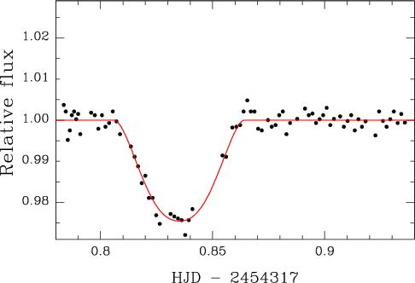
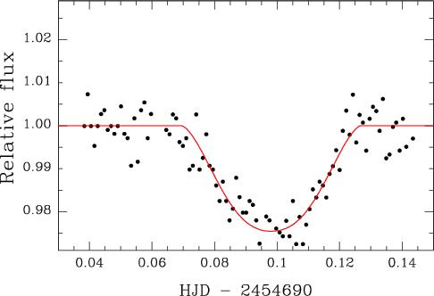
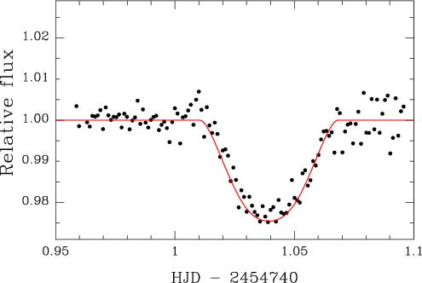
Japanese Transit Observation Network
established by S. Ida and J. Watanabe in 2004
amateur and professional collaboration
  a few 20-30 cm and one 1 m class telescope available
  conduct TTV search from 2008
  achieved less than 1 minute accuracy for TrES-3 transits
  continuous observations will be important

Slide 43
Summary of Previous TTV Studies
Additional planets in transiting planetary systems causes TTV for transiting planets
  detectable TTV is expected for additional planet in mean motion resonance
  ground-based observations (even with small telescopes) are useful to search for additional planets
  in the Kepler era, TTVs will become one of an useful method to search for exoplanets and exomoons
  also, we can characterize orbital parameters of non-transiting additional planets

Slide 44
Summary of past transit studies
“Planetary transits” enable us to characterize
  planetary size, inclination, and density
  obliquity of spin-orbit alignment
  components of atmosphere
  clues for additional planets
such info. is only available for transiting planets
Past studies were mainly done for hot Jupiters
What’s next?

Slide 45
Future Prospects

Slide 46
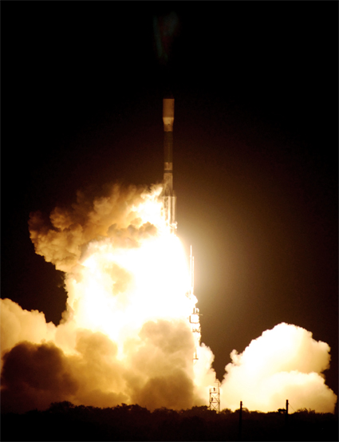
The beginning of the Kepler era
NASA Kepler mission launched 2009 March!
Large numbers of transiting planets will be discovered
Hopefully Earth-like planets in habitable zone may be discovered
Future studies will target such new planets
from Kepler website

Slide 47
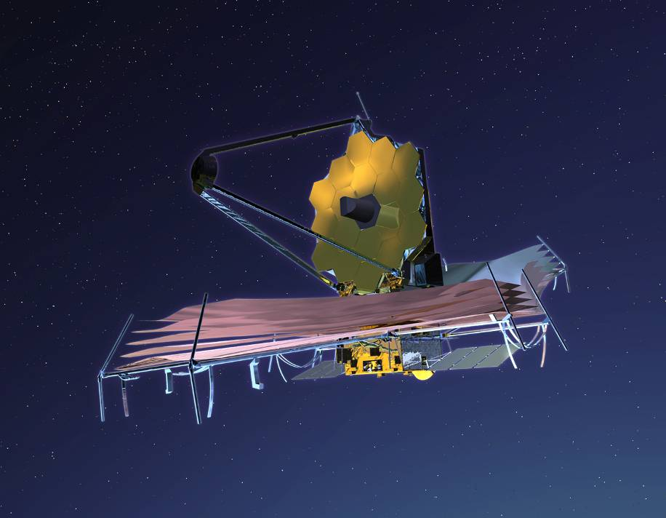
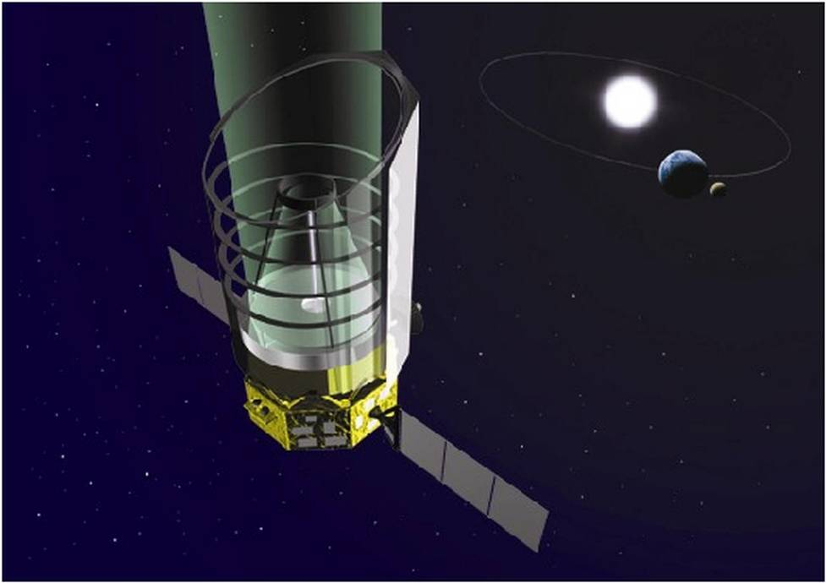
New space telescopes for new targets
James Webb Space Telescope
SPICA
We will be able to observe transits and secondary eclipses of new targets with these new telescopes.

Slide 48
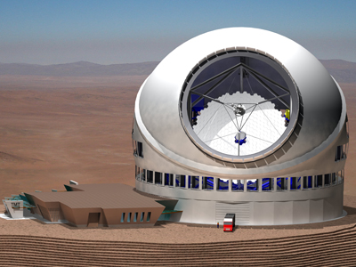
Extremely Large Ground Telescopes
Thirty Meter Telescope
We will be able to extend our studies to fainter targets.

Slide 49
Prospects for future studies
Future studies include characterization of new transiting planets with new telescopes
  many Jovian planets, super Earths, and smaller planets
  rings, moons will be searched around transiting planets
  the RM observations for learn migration mechanisms
  transmission spectroscopy for Earth-like planets in habitable zone to search for possible biomarkers
  TTV to search and characterize smaller planets and exomoons

Slide 50
Summary
Transits enable us to characterize planets in details
Future studies for transiting Earth-like planets will be exciting!

